Slide 1
CSC Winter 2019 Project Decorated Cube With Turtle Patterns
Haode Meng – March 3th, 2019 – C.Wellman
YouTube Link: http://youtu.be/7zaRjLW_1bY?hd=1 (Part A)
http://youtu.be/wTCzfMvga6k?hd=1 (Part B)

Slide 2
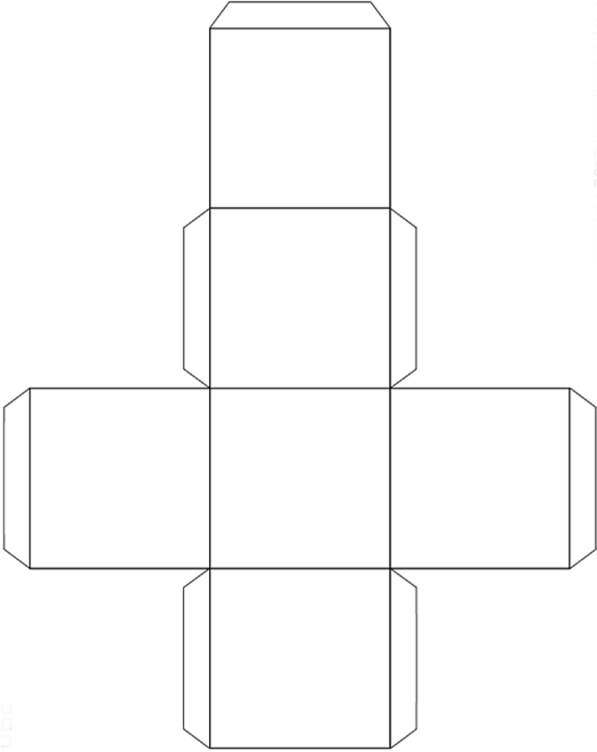

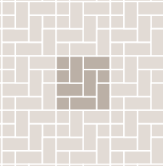
Patterns:
A
B
I choose Pattern A and Pattern C for the project.
Your Pattern
A
Your Pattern
A
C
B

Slide 3


The Pattern I Designed
Four lines of letter M of color gold and turquoise with orange margin.

Slide 4
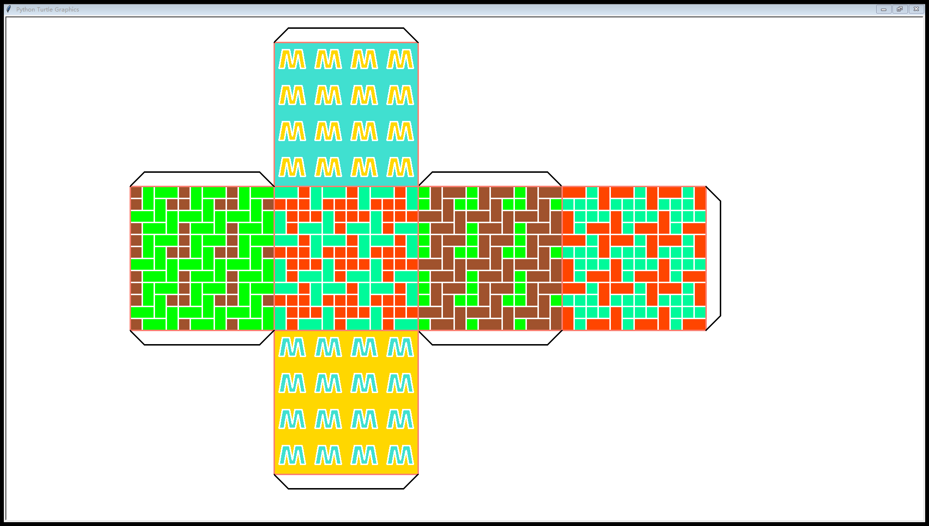
Overview of the Project

Slide 5


Preparing Functions
sc.tracer(0,0) can turn off the animation and speed up the turtle.

Slide 6






Functions for Both Patterns
Example:
Example:

Slide 7



Example:

Slide 8
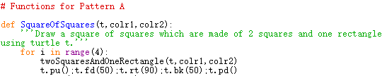

Functions for Pattern A
Example:

Slide 9
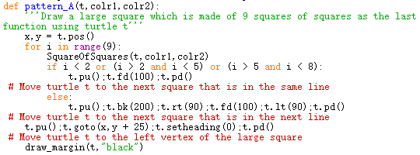
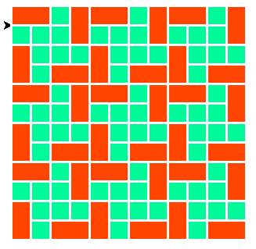
Example:

Slide 10
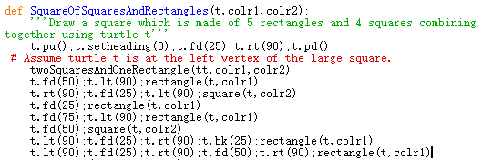

Functions for Pattern C
Example:

Slide 11
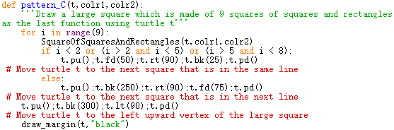
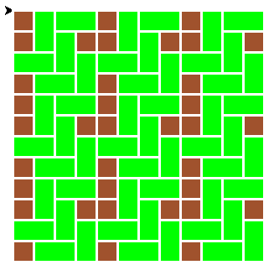
Example:

Slide 12
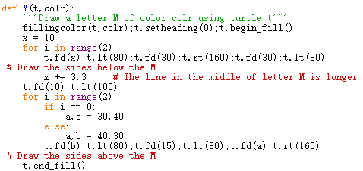

My Pattern
Example:

Slide 13


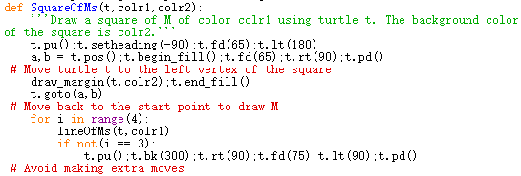

Example:
Example:

Slide 14


Cardstock Cube Project
Example:

Slide 15
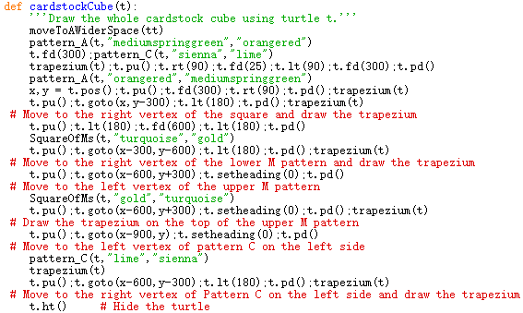
The Final Pattern
Final Function

